Slide 1
Quantifying Missing Law: An Analysis of FTC Actions
Cecilia Brisuda, Yogi Sahu, Benny Craig, Oviyan Anbarasu
Notes:
What is the sociotechnical system and problem in that system you are tackling?
Why is this an important problem?
What were your main findings? (In the case that you are building an app, what does the app do, and demonstrate it if at all possible.)
What broader implications does this have in society, and how do your main findings address an issue (or issues) raised throughout this course?
What lessons should we take away from your work?
What directions, if you were to continue this work in the future, would you want to explore?

Slide 2
Roadmap
Problem
Methodology
Findings
Implications

Slide 3
Sociotechnical System
Wronged . stakeholders
Industry-made technology
Existing law
Notes:
What is the sociotechnical system and problem in that system you are tackling?
The sociotechnical systems in question are companies’ technical systems (tech) and human stakeholders (government, shareholders, etc). Lawsuits are often about technical systems (computing or otherwise) gone wrong because they were imperfect or inappropriately applied. Ultimately, this project analyzes how the government (i.e., socio-) responds to these technical systems using the tools of litigation and consent decrees.

Slide 4
Reality… and problem
Goal:
Quantify the problem,
Identify biggest gaps
Wronged . stakeholders
Industry-made technology
Existing law
Notes:
Problem: unavailability of law (small) and hard to apply (why it’s far away from the other gears)

Slide 5
Problem due to incentives in corporations
Good corporate behavior
Monetary incentives to behave (challenge: market incentives to misbehave)
Corporate governance
Non-market effects
Legal consequences
Always challenging, worse in tech
Some, but weak
Notes:
Why is this an important problem?
Non-market:
Employes
Regulation
Reputation
Etc.

Slide 6
Solution
Goal:
Quantify the problem,
Identify biggest gaps
Legislatures need to know what problems are most lacking in causes of action
If they don’t already exist, legislatures and courts need to create those laws
Lawsuits require legal “causes of action” – laws that the company violates
Lawsuits are costly thus effective
Add incentives and forces to behave

Slide 7
Methodology
Acquired documents from the Federal Trade Commission
Identified Environmental, Social, and Governance (ESG) problems
Counted frequency of ESG terms in FTC docs
Normalized word count by total words per industry
Largest regulator of tech
See Appendix 1

Slide 8
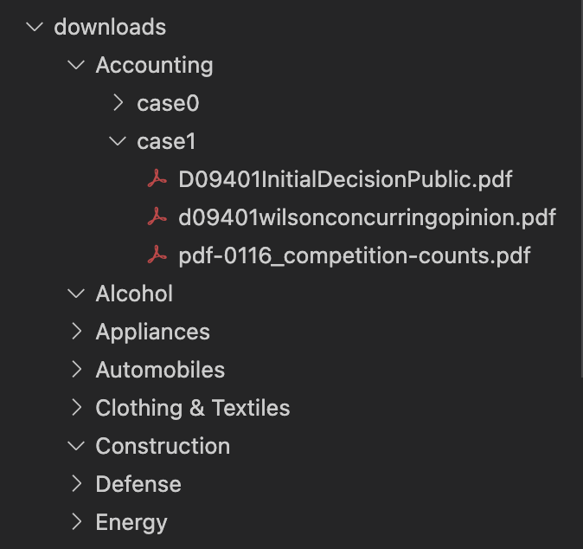
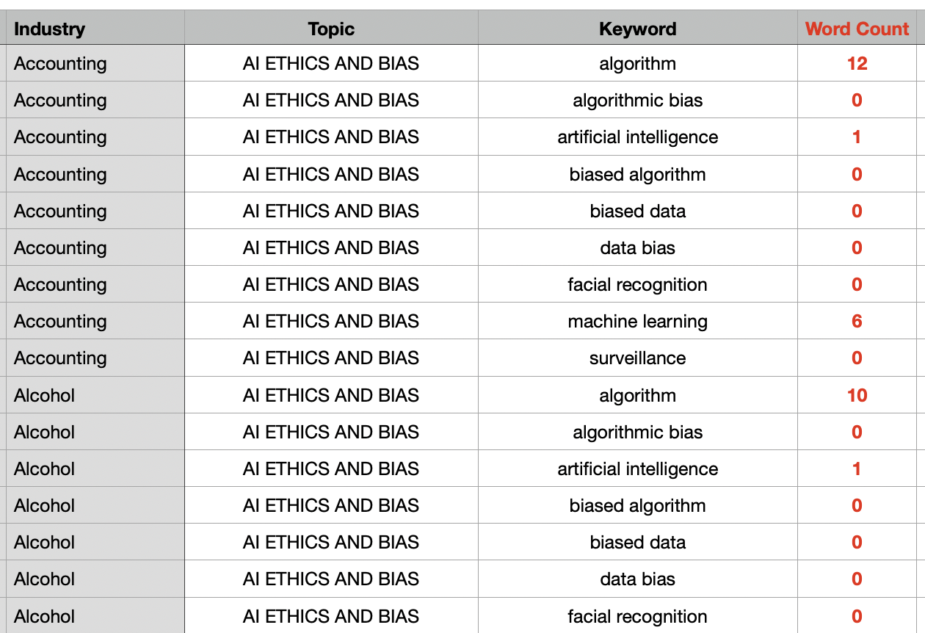
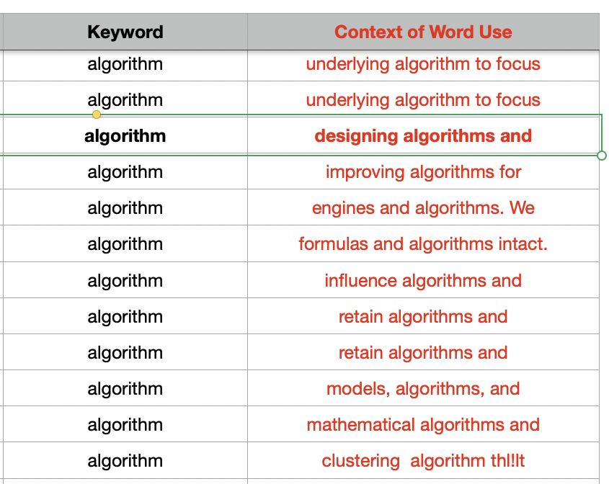
Data Gathered
Download PDFs
Word Counts
Context of Use
Over 4,500 documents
Analyzed 29 million words

Slide 9
Most frequently used terms

Slide 10
Words that did not appear at all
Biased data/data bias
Differential Privacy
Greenhouse gases
Extremist content
Platform responsibility
Content moderation
Notes:
What were your main findings?

Slide 11
Findings on Terms
Machine Learning
Found in every industry, though rarely
All industries
Esp: Government, Technology, Healthcare, Finance
Algorithm
Notes:
What were your main findings?
machine learning showed up in every industry but at very low rates. could be a indicator of how applicable machine learning is to anything
algorithms could have more cause of action in the public sector

Slide 12
Findings on Terms
Found in every industry
Esp: Technology, Entertainment, Healthcare, Government
Privacy
0 uses
Suggesting nuanced definitions are not being used in court
Differential Privacy:
Notes:
What were your main findings? (In the case that you are building an app, what does the app do, and demonstrate it if at all possible.)
differential privacy 0 used can not be used conclude that government does know about differential privacy, would not too surprising to see it show in court cases considering the census beureua uses it as a privacy technique

Slide 13
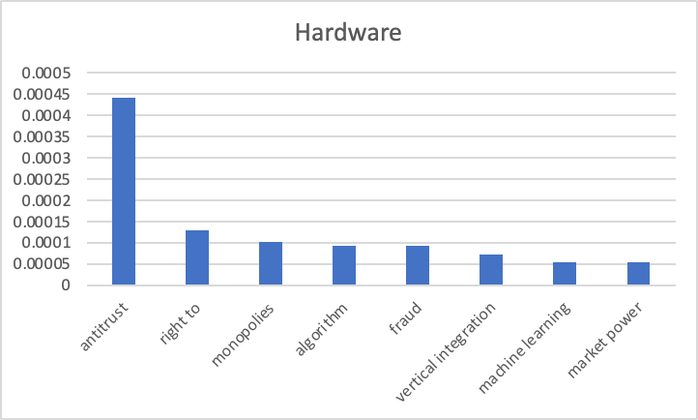
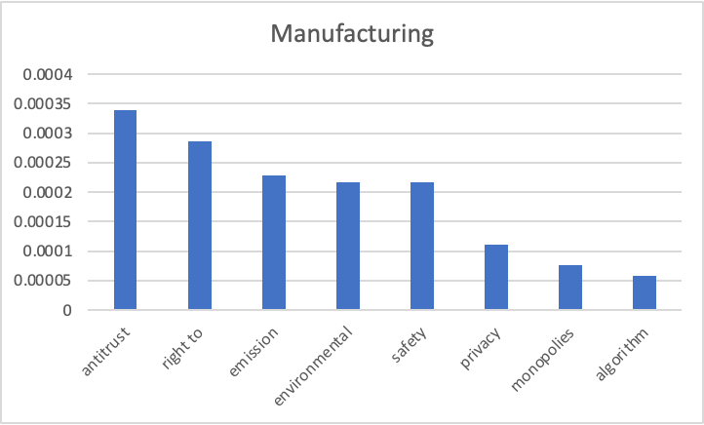
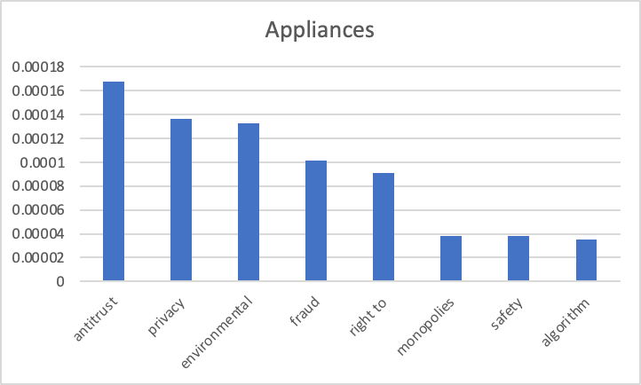
Comparing most similar industries
Notes:
anti trust right to may relate to “right to repair” but we don’t know for sure, which is connected anti trust connection
vertical integration only appears in hardware. An example of this outside of class is Apple silicon. Apple used to buy chips from other manufacturer, but now they are a company this is big enough to r&d their own chips could be related
terms related to climate change appear in manufacturing and appliances, which we would expect since manufacturing as an industry encompasses factories (environmental)

Slide 14
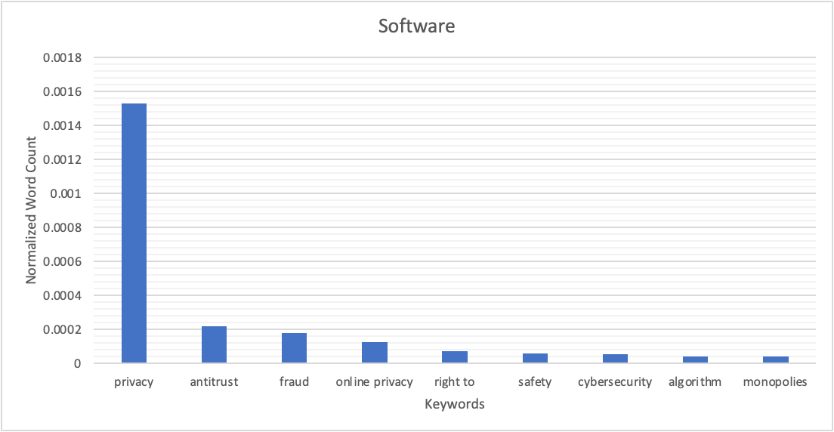
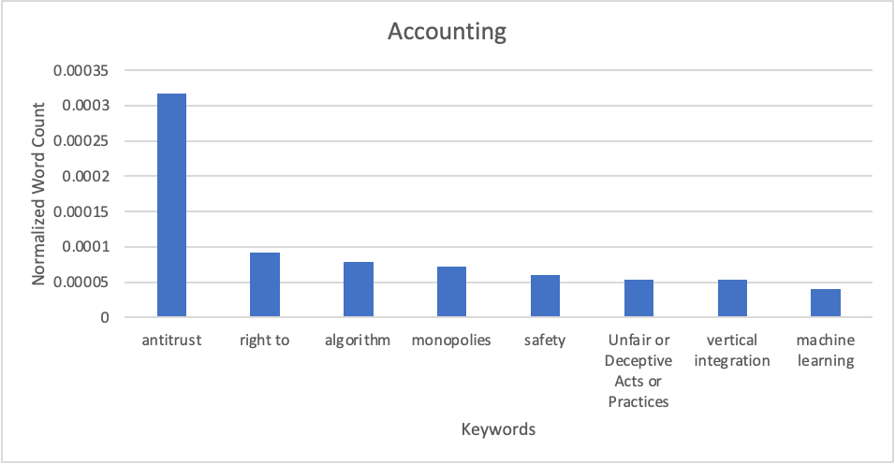
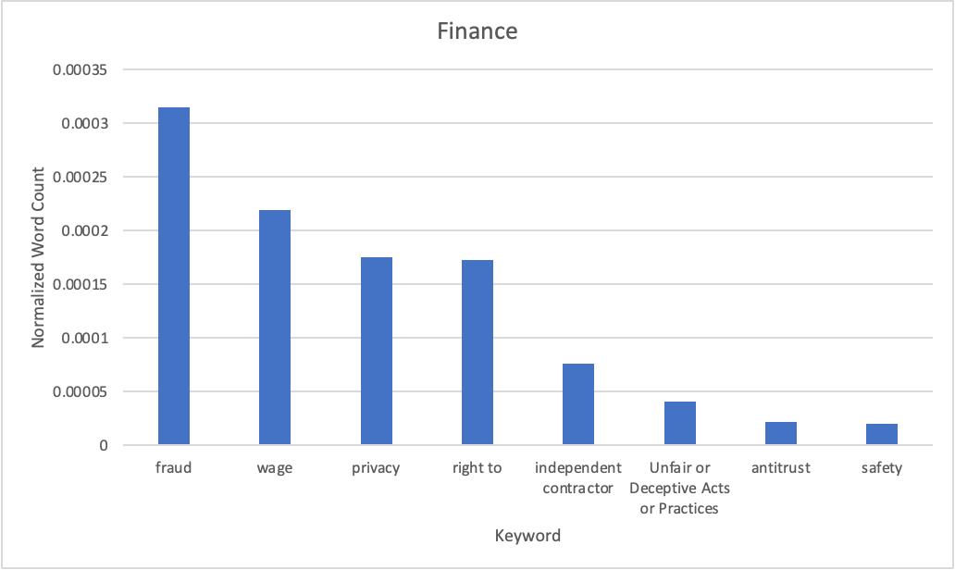
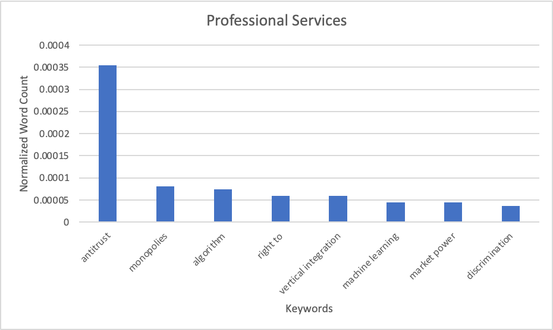
Comparing most similar industries
Notes:
privacy dominates in software, which we would expect since privacy became a mainstream topic after the facebook scandal
even though we are seeing industries different than hardware, antitrust could prevalent topic within all industries
professional services include marketing, advertising, and legal services. expect privacy to be on their since marketers have to target ads somewhere

Slide 15
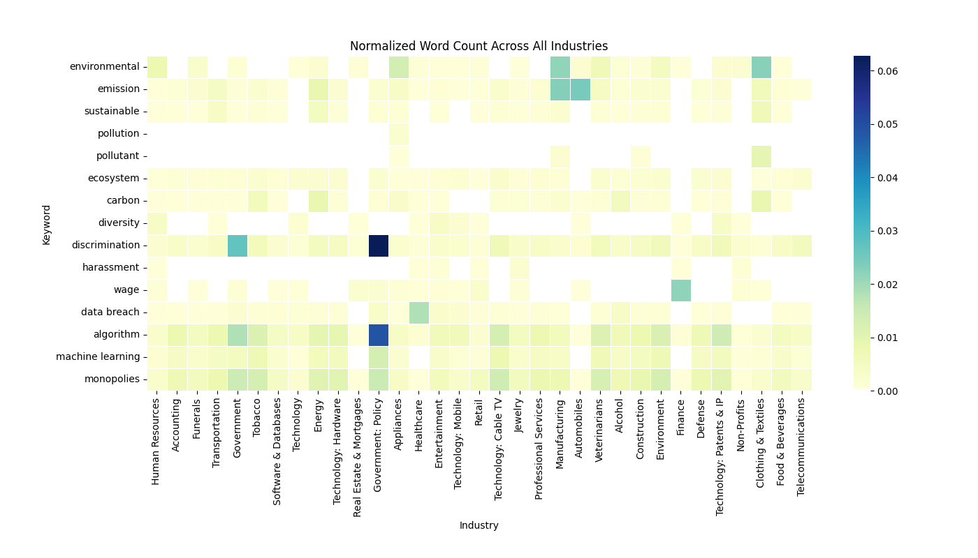
Heatmap of Word Usage
Normalized Word Count (%)
Notes:
emission is a concern in manufacturing and automobiles, but not in technology and databases
Interesting correlation between algorithm and monopolies across industries
Couldn’t put privacy keyword on heatmap because it appeared so much it made all the other squares too light

Slide 16
Social implications
FTC, as primary tech regulator, needs causes for:
Cybersecurity
Algorithmic/data bias
ML, broadly
Misinformation, other platform harms
Hot-topic of privacy overblown?
Notes:
What broader implications does this have in society, and how do your main findings address an issue (or issues) raised throughout this course?

Slide 17
Limitations and next steps
Use more representative/broader dataset
FTC regulates consumer-facing behavior, limited to FTC Act
Ideal: private lawsuits
Unfiltered for type of FTC action
Use more sophisticated analysis
“Bag of words” vs. topic modeling
No analysis of statistical significance
Compare FTC statements vs. actions

Slide 18
Takeaways for class
What you can get away with
What to advocate for as member of democracy
Security, bias, pro-social platforms
Technologists must do it because govt. isn’t
Understand tools like explainability, differential privacy, and others discussed in class
Encourage digital literacy so individuals can self-protect (where relevant)
Notes:
What lessons should we take away from your work?

Slide 19
Thank you!
Questions?

Slide 20
Appendix 1: Search Terms - Environment
Environmental
biodiversity
climate change
climate goals
emissions
environmental justice
environment
pollution
sustainable sustainability
water and marine resources
greenhouse gas emissions
natural resource use
Pollution
Biodiversity
Ecosystem
carbon offsets
packaging and waste
water stress
raw material sourcing
waste management

Slide 21
Appendix 1: Search Terms - Social
DEI
diversity equity and inclusion
diversity
forced labor
human rights
local community impacts
Equal pay
discrimination
sexual harassment
racial harassment
Wages
labor conditions
child labor
working conditions
employee relations
safety
working conditions
labor conditions

Slide 22
Appendix 1: Search Terms – Corporate Governance
governance
corporate governance
board composition
board and management diversity
company audits
executive compensation
investor activists
misleading or false proxy statements
shareholder rights and policies

Slide 23
Appendix 1: Search Terms – Computing
employee and customer data breaches
Privacy
cybersecurity
data breach
security breach
BIPA
CCPA
Section 230
Misinformation
Censorship
algorithmic bias
AI ethics
artificial intelligence
machine learning
facial recognition
surveillance
biased algorithms
data bias
fairness
accountability
transparency
explainable AI

Slide 24
Appendix 1: Search Terms – Misc.
affordability and accessibility of products
conflict minerals
ethical supply chains
product life cycles
Corruption
fraud
Title XI
UDAP
UDTP
Negligence
False advertising

Slide 25
Appendix 1: Search Terms – Platforms, Digital Rights
content moderation
platform responsibility
user-generated content
online harassment
hate speech
extremist content
disinformation
online radicalization
platform policies
harmful content
digital rights
digital divide
net neutrality
internet access
digital inclusion
accessibility
digital literacy
online privacy
freedom of expression
digital citizenship

Slide 26
Appendix 1: Search Terms – Gig Economy
gig economy
worker classification
independent contractors
employee rights
labor laws
platform workers
contingent workforce
benefits
worker protection

Slide 27
Appendix 1: Search Terms – IP & Competition
intellectual property
patents
copyright
trademark
trade secrets
patent infringement
licensing
fair use
piracy
open source
proprietary software
antitrust
monopolies
market dominance
competition law
anti-competitive behavior
market power
mergers and acquisitions
predatory pricing
vertical integration

Slide 28
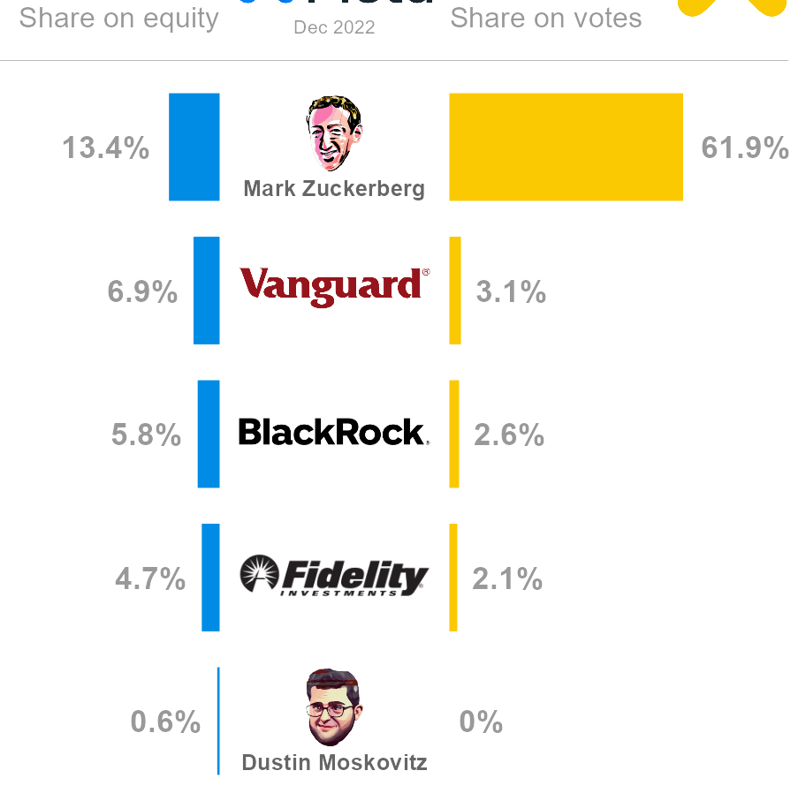
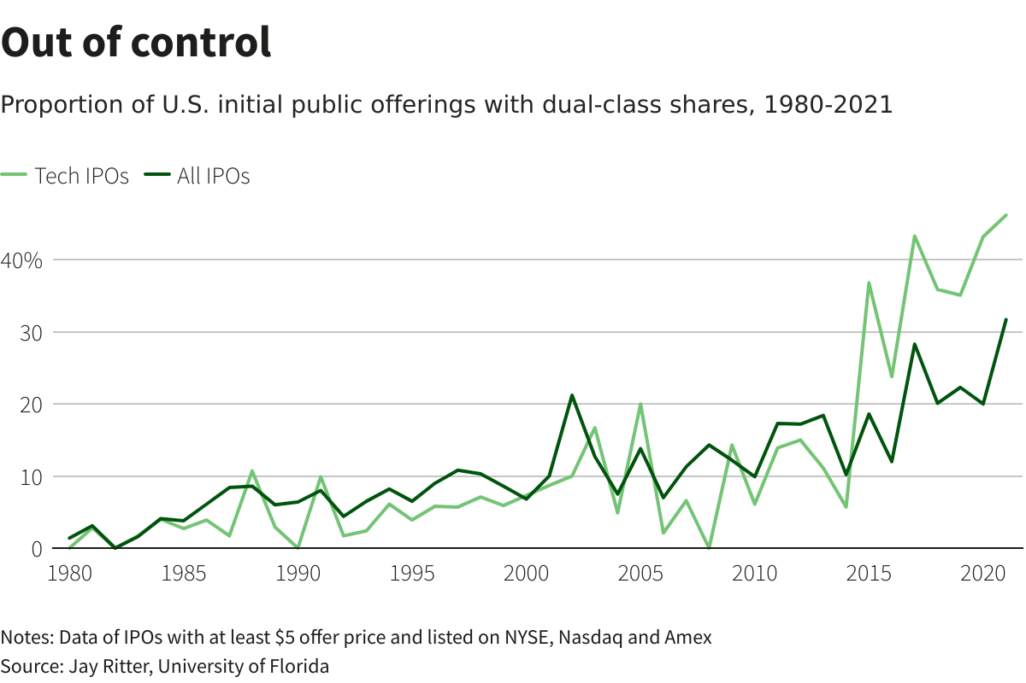
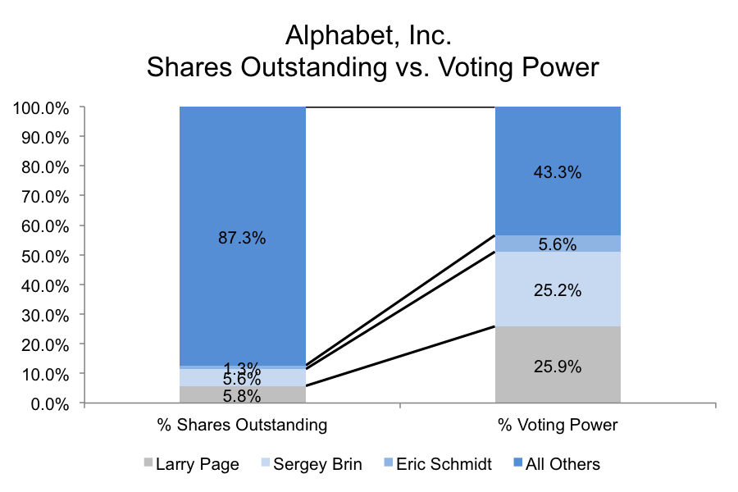
Appendix 2 – Share Structure Problem

